Slide 1
I-40 Prewitt (Exit 63) Interchange Reconstruction Project
CN 6101730
Public Meeting #1
10/09/24

Slide 2
Agenda
Introductions
Project Background
Existing Conditions
Next Steps
Q&A

Slide 3
Project Background
In cooperation with the Federal Highway Administration (FHWA), the New Mexico Department of Transportation has initiated a corridor study of I-40 that is going on concurrently (2024).
As a result of this study, the Prewitt and I-40 interchange (Exit 63) has been identified as an area in need of safety and traffic flow improvement.
To begin evaluating transportation needs in this area, the Northwest New Mexico Council of Governments (NWNMCOG) has initiated the I-40 Prewitt Interchange Reconstruction Project.

Slide 4
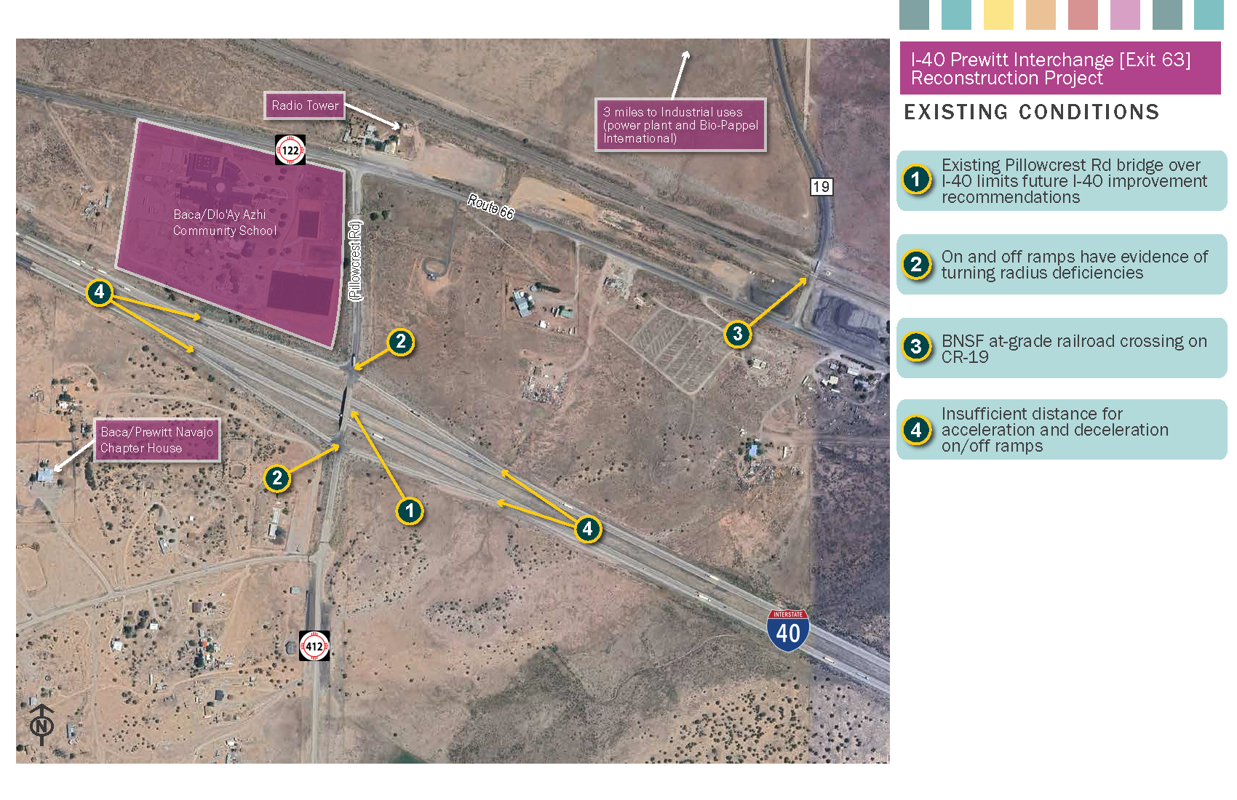
Existing Conditions

Slide 5
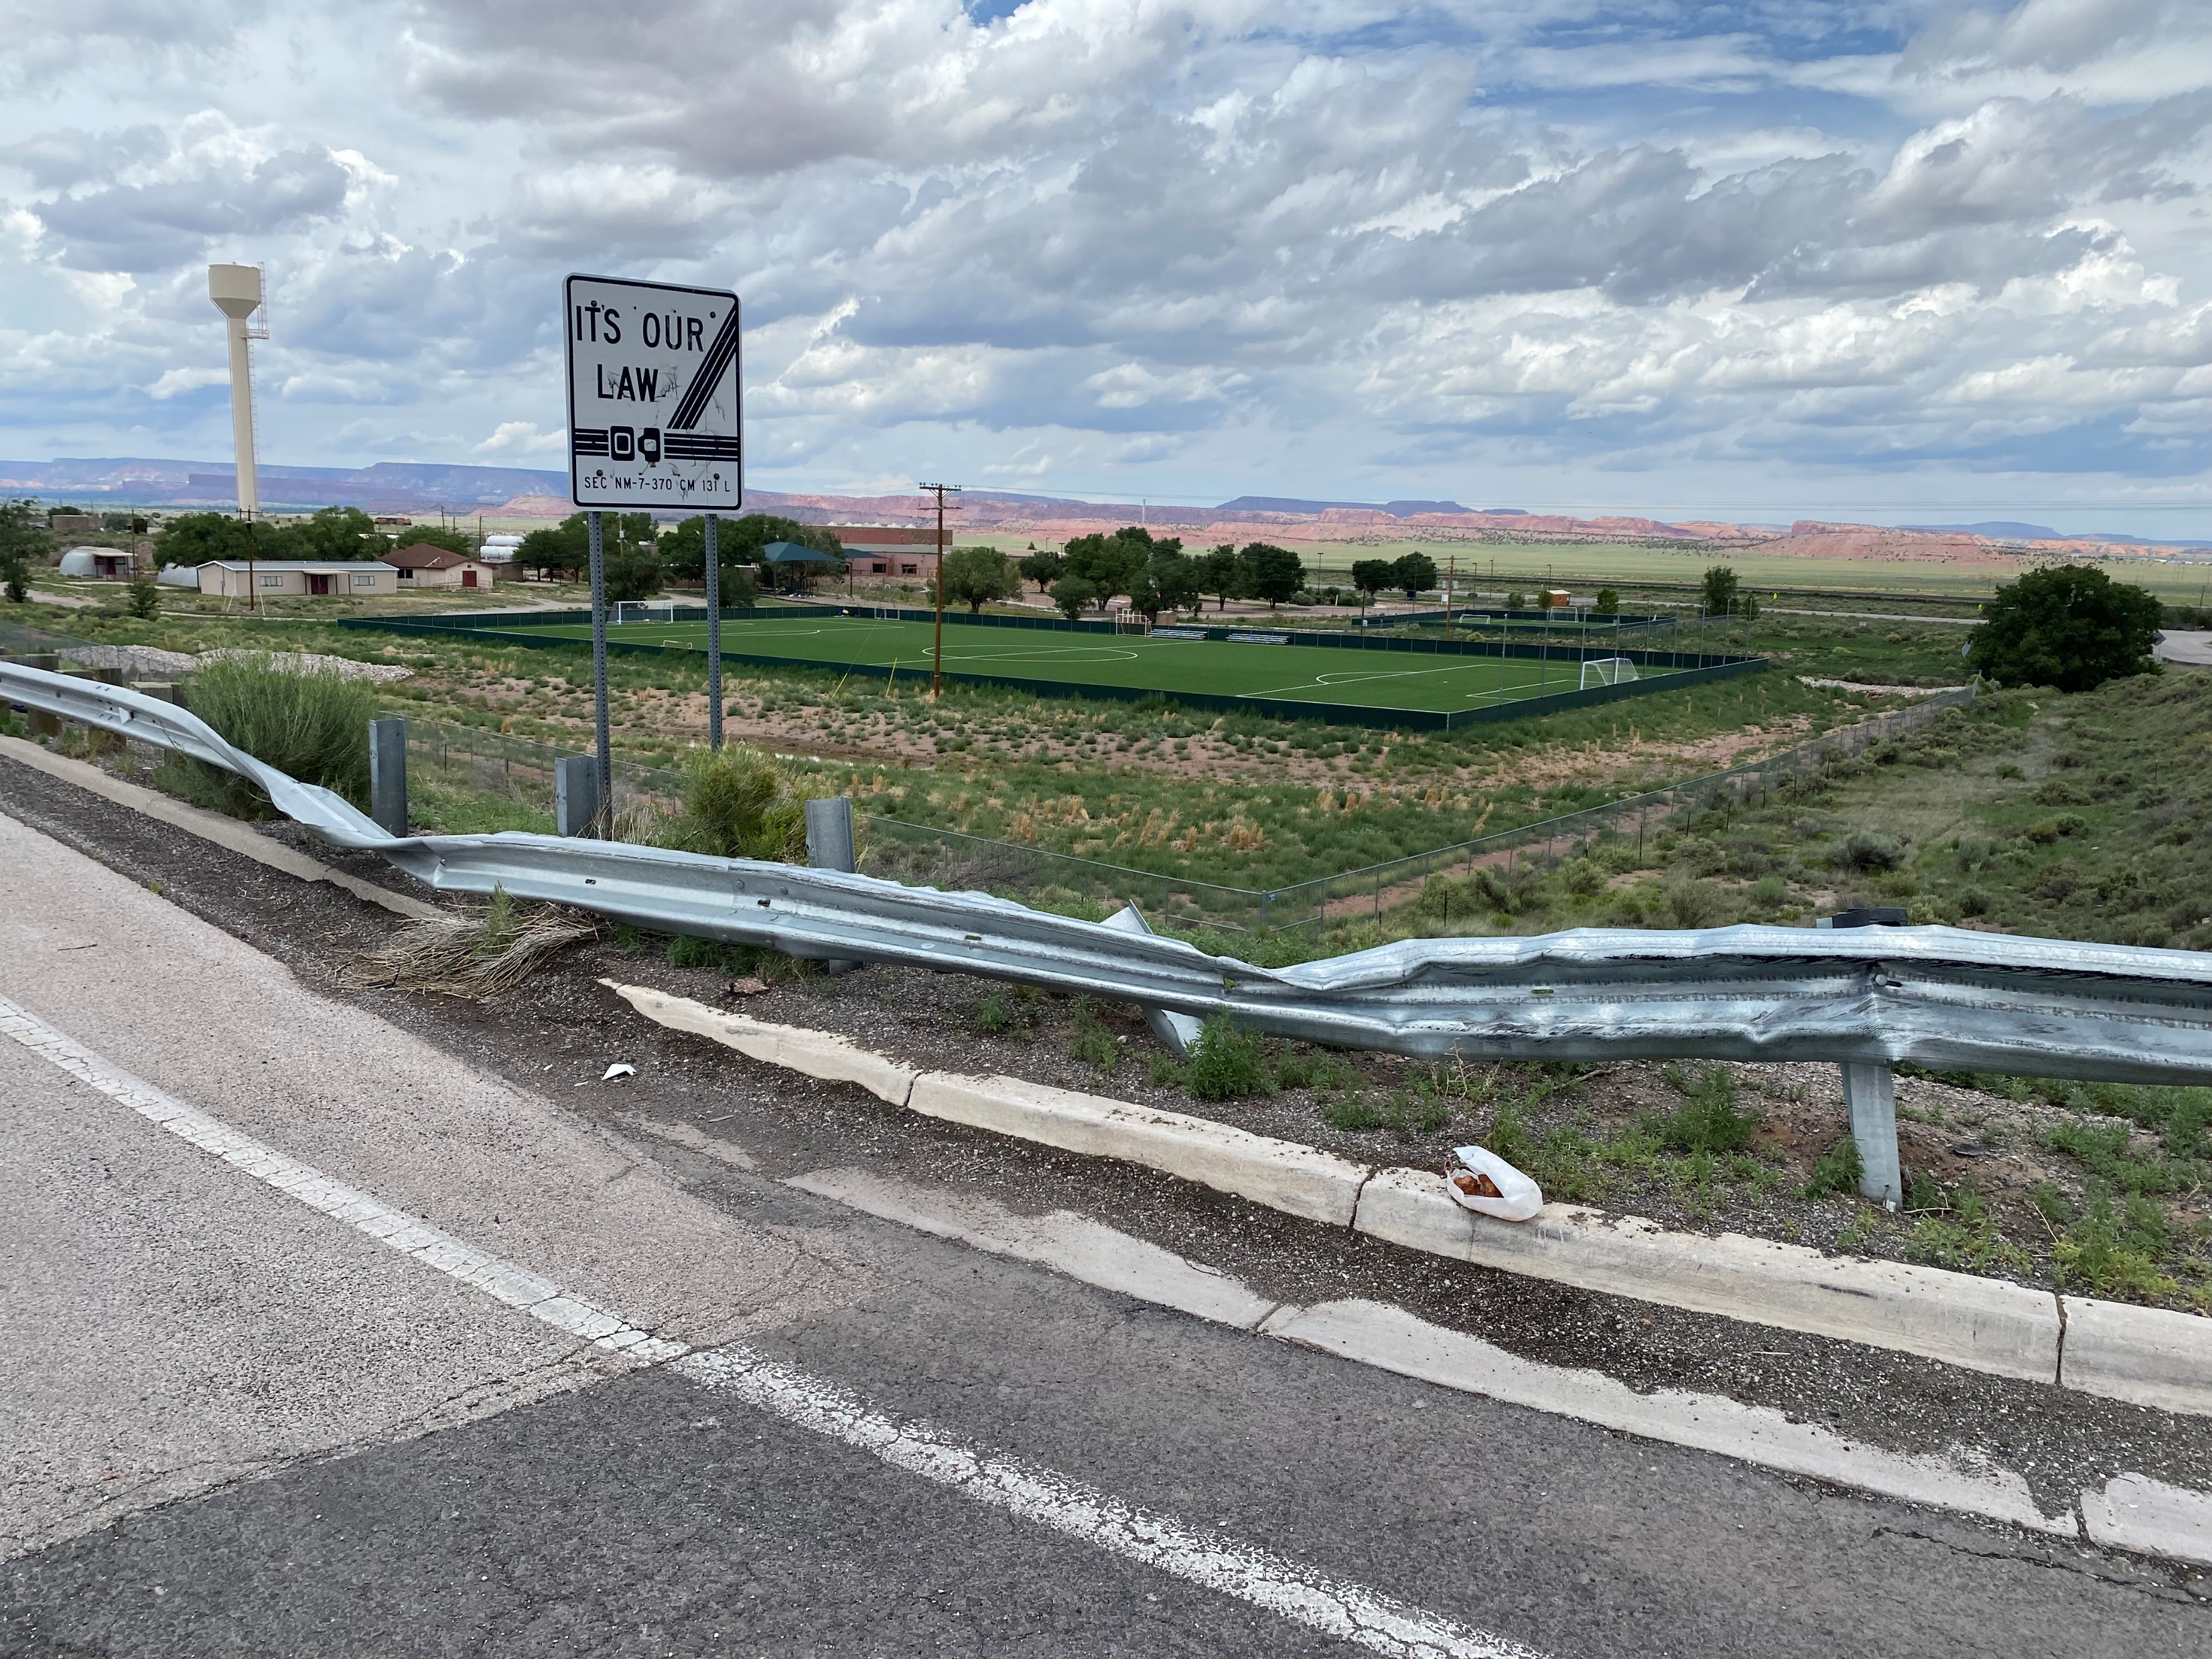
Existing Conditions
I-40 westbound on ramp
Damaged guardrail (evidence of crashes)
Westbound off ramp (onto Route 66122)
Narrow turn radius (semis turning onto traffic)

Slide 6
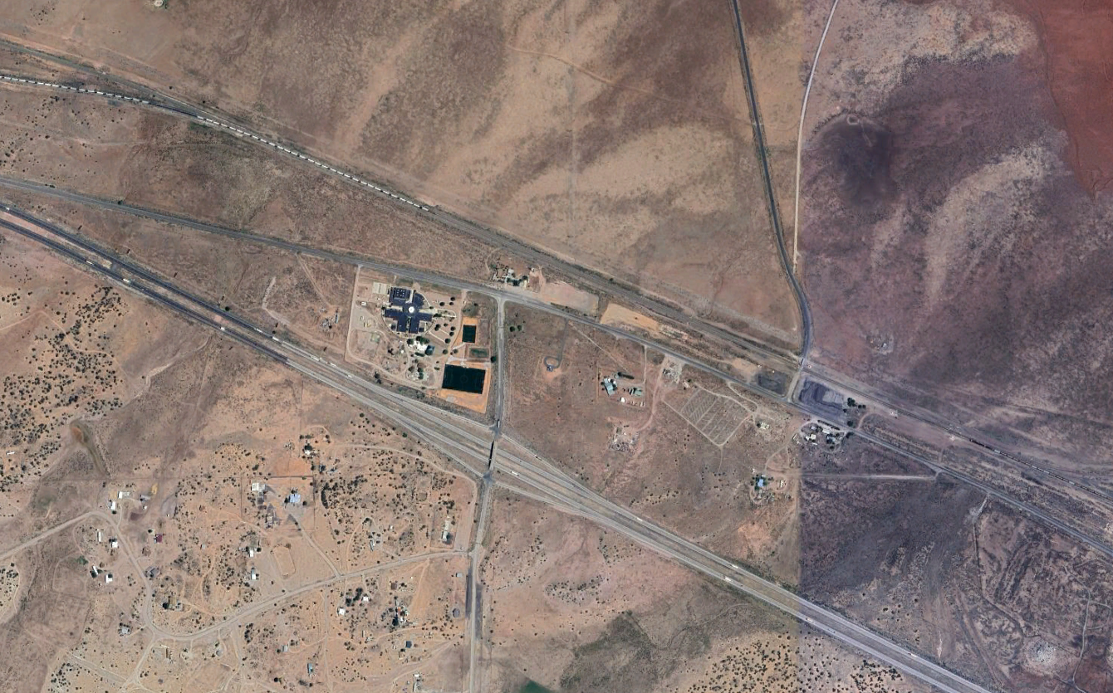
Existing Conditions Cont’d
Limited connection to
One design in discussion is redesigning the interchange to connect County Road 19 (CR-19) to I-40

Slide 7
Next Steps
Incorporate public feedback
Identify “Initial Alternatives”
Public Meeting # 2
Review public input and further analysis to develop “Refined Alternatives”
Public meeting #3

Slide 8
Next Steps Cont’d
Identify “Preferred Alternative” that meets the communities needs
Public Meeting #4
Design and Construction Phase Begins

Slide 9
Q&A Session Questions to Think About
Have you or anyone you know experienced safety issues at this interchange?
How do you use the interchange? To get to work, home, or other trips nearby? Do you use it to get somewhere further away?
Would you like to see anything different at this interchange?
How do you access Route 66?
How do you access services in the area?

Slide 10
How to submit Public Comments
In-person with the comment forms
Via email at
info@prewittinterchange.com
Comment period will be open until Nov. 9th !

Slide 11
Thank you! Please take a chance to look at the boards and talk to the project team!

